Slide 1

1
Smart Dustbin
Presented By :-Ashsih Jha, Nikhil Rawal, Harmandeep Singh, Kanwardeep Singh, Ripanjeet Singh Sidhu, Guninder Pal Singh
CHITKARA UNIVERITY PUNJAB
Department of Computer Science and Engineering

Slide 2
Contents
2
Abstract
Introduction
Proposed System
Components Required
Working
Circuit Diagram
Coding
Screenshot Pictures
Advantages
Future Scope
Conclusion

Slide 3
Abstract
3
Of late positive steps are taken to boost the level of cleanliness in our country.
People are getting more effective in taking all the possible steps to clean their neighborhood.
We have made a system which will notify the municipal corporations or the cleaners to empty the dustbin when the dustbin gets full.
When the garbage will reach a certain level, a notification and an email will be sent to the municipal corporation's office and the cleaners mobile so that the workers can take further actions to empty the dustbin.
This system will support in cleaning our surrounding in a better way.

Slide 4
Introduction
4
Provide an IOT based solution to garbage collection
Planning for enabling collection of garbage generation data.
This checks the waste level of the dustbins by using Sensor.
Once detected this system immediately alerts the concern authorized
through SMS/E-mail.
An android application is used for the desired
notification.
This ensueres a hygienic environment and supports the Swachh Bharat for cleanness.

Slide 5
Proposed System
5
Real time waste management system to check the level of garbage in dustbins.
It will inform the status of each and every dustbin so that concerned authority can send the garbage collection vehicle.
The level of waste in the dustbins is detected with the help of Ultrasonic sensor.
When the measured value of sensors exceeds a certain threshold value then SMS and E-mail is Sent To Authorized person.

Slide 6
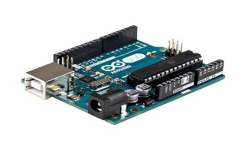
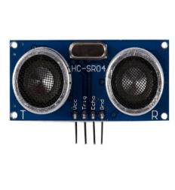
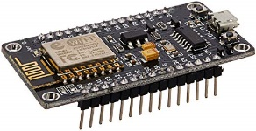
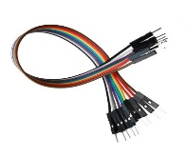
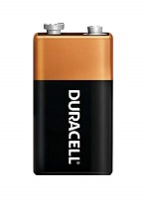
Components Required
6
Arduino UNO
Ultrasonic Sensor Module HC-SR04
Node MCU ESP8266
Connecting Wires
Battery

Slide 7
Working
7
Step 1: First of all, when we start the device name of project is displayed on screen that is “Smart Dustbin” and then device comes in event detection state.
Step 2: The device will remain in event detection state till the dustbin is not completely filled. In this state the Ultrasonic sensor HC-SR04 continuously detects the level of dustbin and keeps on transmitting the data to the Blynk application with is help of NodeMCU ESP8266 module.
Step 3: The Blynk app will keep on analyzing the data sent by HC-SR04 and when the data will cross certain limit it will trigger notification event.
Step 4: When the notification event will be triggered by the app the cleaners will get a notification on their phone telling them that the dustbin is full and needs to be emptied as soon as possible.
It will also send an email regarding the status of the dustbin to the workers and municipal corporation.
Step 5: After the dustbin is emptied the HC-SR04 will send a signal to the app and the device will again go into event detection state in which it was initially and same process is repeated according to the level of dustbin.

Slide 8
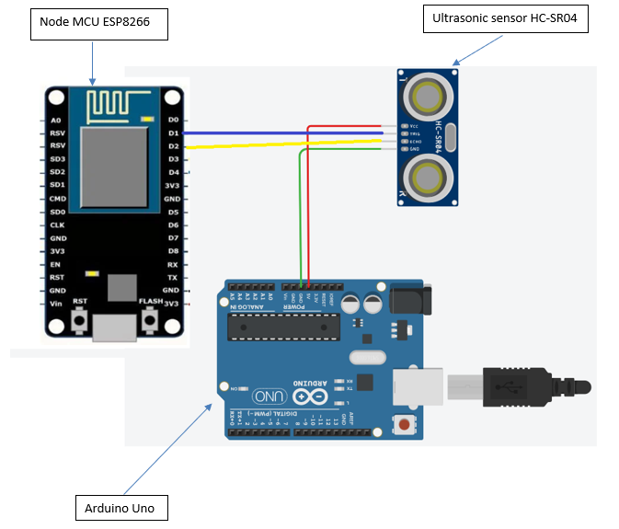
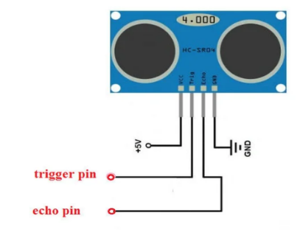
Circuit Diagram
8
Fig(ii). Ultrasonic sensor HC SR-04
Fig(i). Circuit Diagram

Slide 9
Coding
9
#define trigger 5
#define echo 4
#define BLYNK_PRINT Serial
#include <ESP8266WiFi.h>
#include <BlynkSimpleEsp8266.h>
char auth[] = "4pMgUxjM4vFyIXmYhCE4upWI1PhQjn54";
char ssid[] = "Samsung";
char pass[] = "ashishj@samsung";
void setup()
{
Serial.begin (9600);
Blynk.begin(auth, ssid, pass);
pinMode(trigger, OUTPUT);
pinMode(echo, INPUT);
}
void loop()
{
long duration, distance;
digitalWrite(trigger, LOW);
delayMicroseconds(2);
digitalWrite(trigger, HIGH);
delayMicroseconds(10);
digitalWrite(trigger, LOW);

Slide 10
Coding
10
duration = pulseIn(echo, HIGH);
distance = duration*0.034/2;
Serial.println(distance);
Blynk.virtualWrite(V0, distance);
//if (distance <= 5) {
// Blynk.virtualWrite(V0, 0);
/*}
if (distance >=6 && distance <=100 ) {
Blynk.virtualWrite(V0, 8);
}
if (distance <= 6) {
Blynk.virtualWrite(V1, 255);
}
else {
Blynk.virtualWrite(V1, 0);
}
if (distance <=3) {
Blynk.virtualWrite(V2, 255);
}
else {
Blynk.virtualWrite(V2, 0);
}*/
Blynk.run();
}

Slide 11
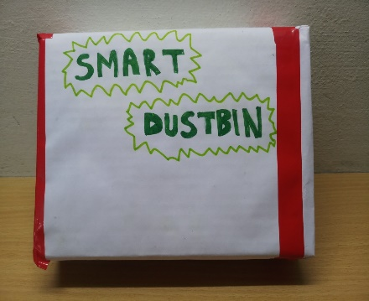
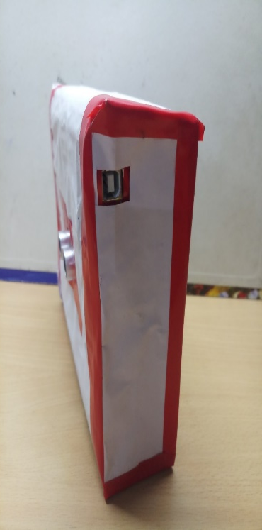
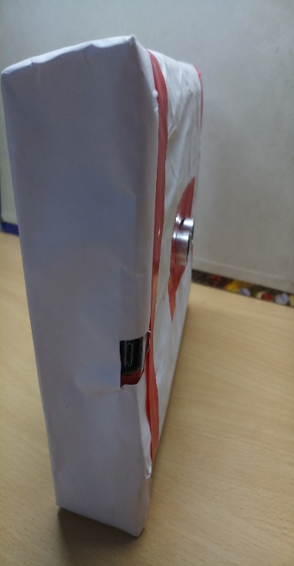
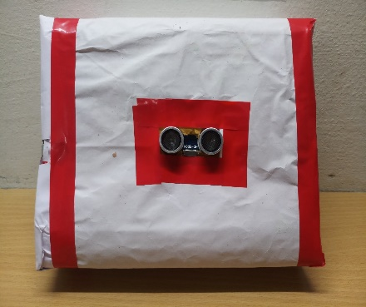
Screenshot Pictures
11

Slide 12
Advantages
12
Our system provides greater accessibility to the dustbin.
It will save fuel and time using appropriate route planning.
This practice is highly lucrative.
Keeps the environment clean and fresh.
The environment will become more cleaner and the odors of the garbage will be fewer.

Slide 13
Application
13
Empowers Swach Bharat Mission.
Based on Digital India.
Reduce environmental pollution.
Real time based cleaning of our cities.

Slide 14
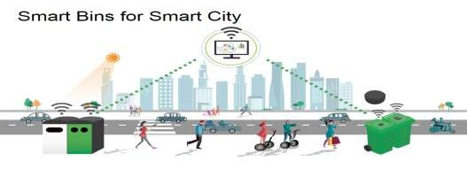
Future Scope
14
This project is made for demo concern, it can be taken to product level.
Two bins can be placed to collect wet and dry waste separately.
Wet waste can be decomposed and used for making biogas.
It can be made durable, by making it compact and cost Effective

Slide 15
Conclusion
15
This system help the local municipal administration in waste management system. A web server is also been set up through which the municipal authorities also get information about the bins in their area. It uses sensors for sensing information of bins and sending to workstation, which is situated at municipal office for finding shortest path.
This project came in comfortable which a worthy elucidation for maintaining green environment. The proposed system is an attempt to improve current waste collection system in India for the “Clean India Mission”.

Slide 16
16
Thank You

